Slide 1

HEALTH MONITORING SYSTEM
FOR BETTER TRANSPERENCY AND HEALTH CARE

Slide 2
INTRODUCTION
Health Monitoring System is a IoT device used to monitor the temperature, pulse rate and oxygen level in blood and send alerts to doctor in case of critical situations. There is also a panic button in the system if a patient wants to send alerts to certain family members in case of any mishaps.

Slide 3
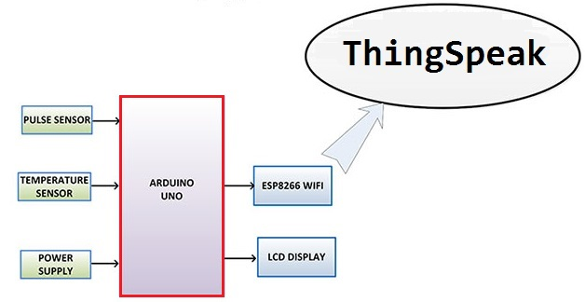
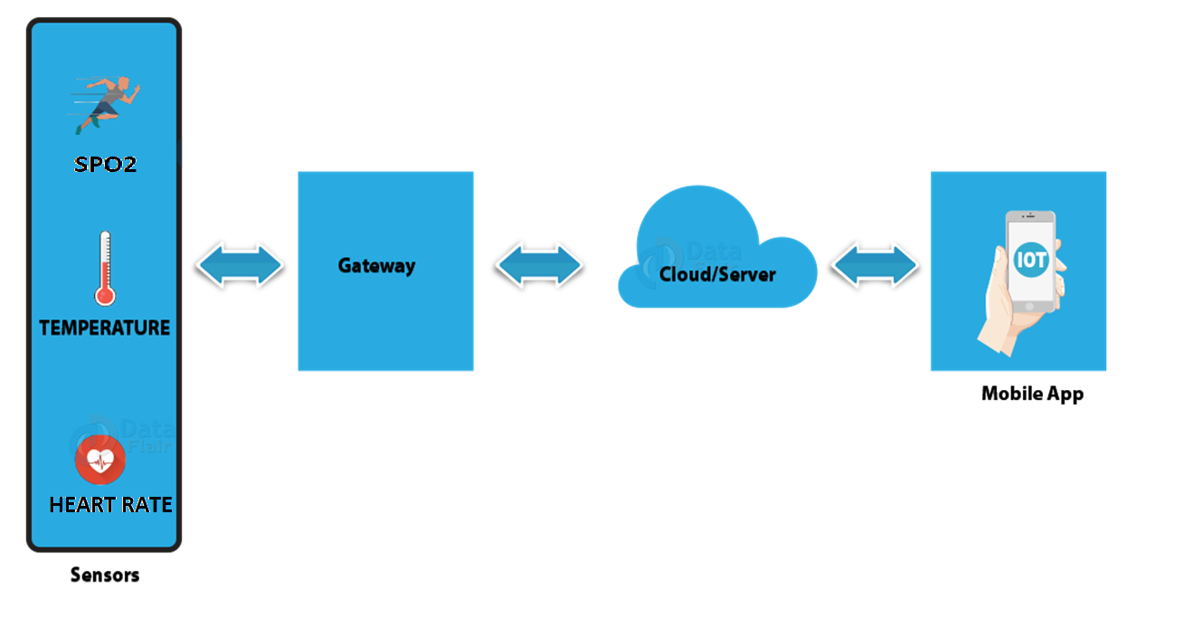
BLOCK DIAGRAM

Slide 4
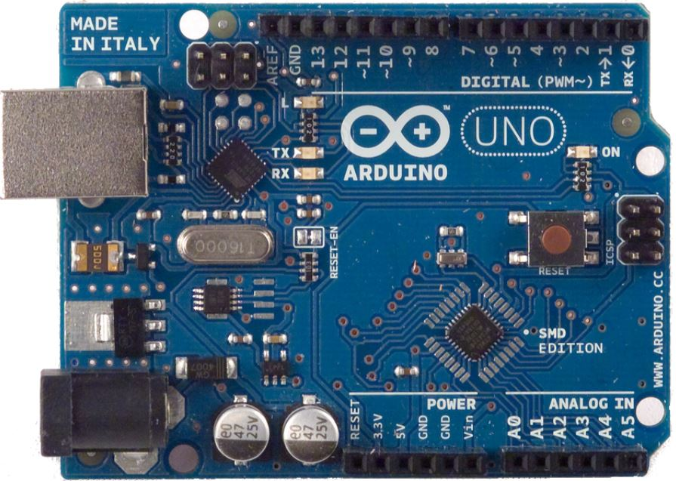
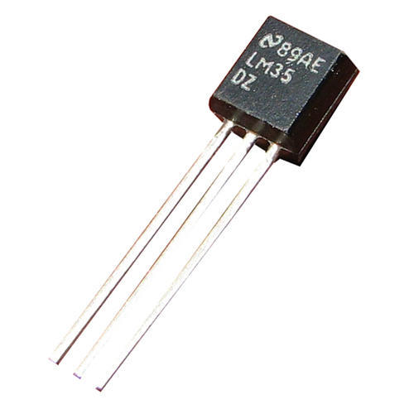
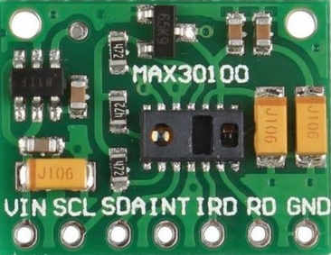
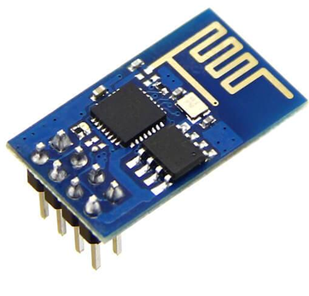
HARDWARE
ARDUINO
LM35 SENSOR
PULSE OXIMETER SENSOR
(MAX30100 MODULE)
WiFi MODULE
(ESP8266)

Slide 5

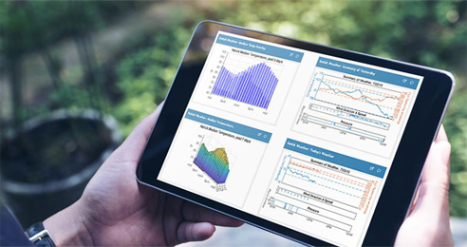
ThingSpeak serves as our IoT platform to store data obtained through the sensors and also visualize it.
ThingSpeak is an open-source Internet of Things (IoT) application and API to store and retrieve data from things using the HTTP and MQTT protocol over the Internet.

Slide 6


APPLET
DISPLAYING IN PHONE THROUGH APP
We use IFTTT to create applets which on receiving trigger by monitoring data in ThingSpeak sends alerts to doctors’s phone through LINE App.

Slide 7
WORK FLOW
SELECTION OF TOPIC
1*3 HOURS
RESEARCHING FOR THE PROJECT
12*3 HOURS
BUILDING THE HARDWARE CIRCUIT AND CODING
5 HOURS
DEBUGGING AND TESTING
6 HOURS
IMPROVISATION
5 HOURS

